Slide 1

Cheese

Slide 2
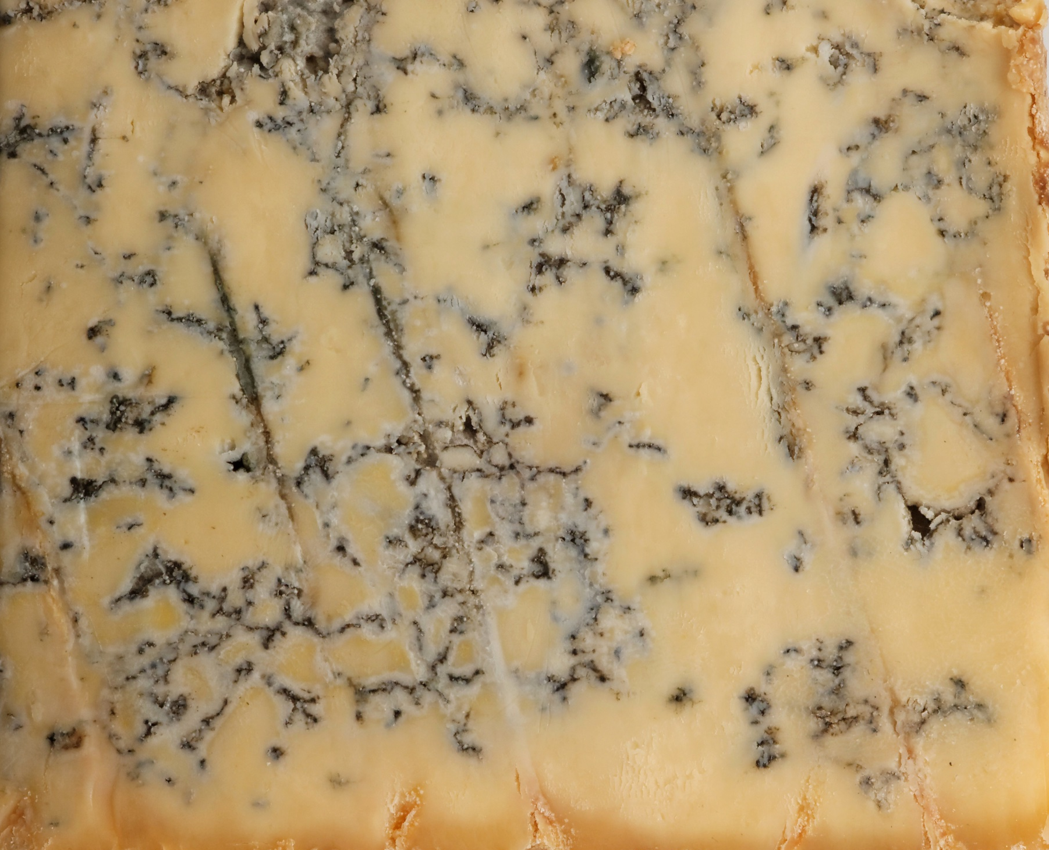

Slide 3
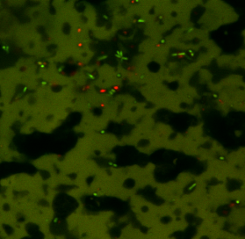

Slide 4
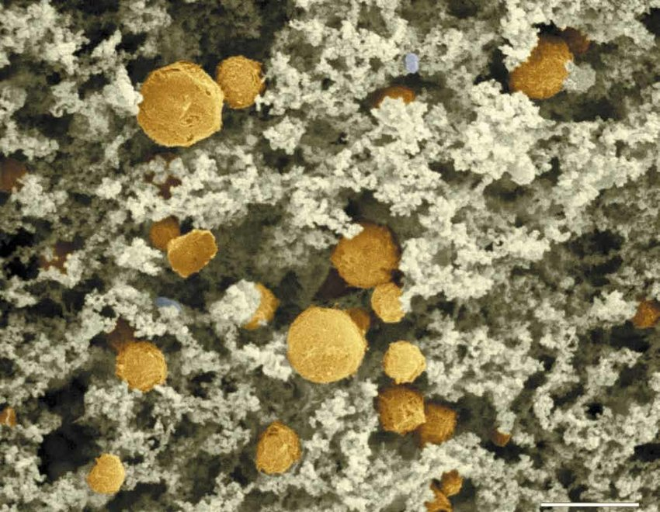

Slide 5
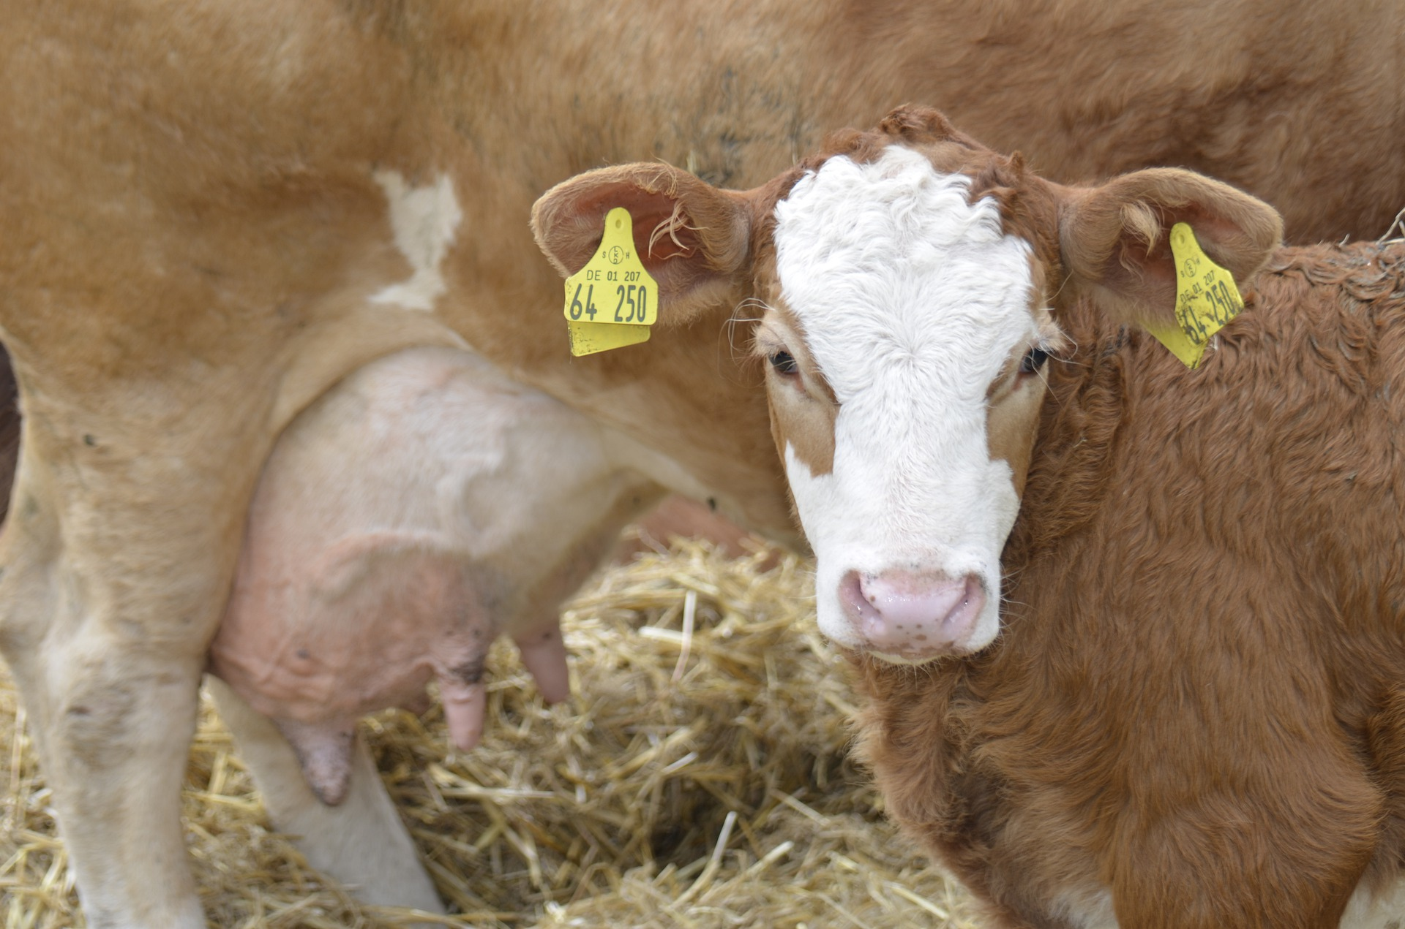

Slide 6
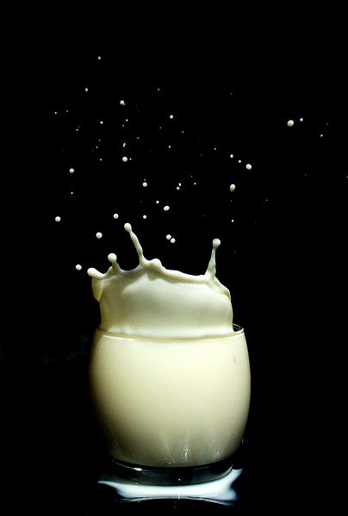

Slide 7
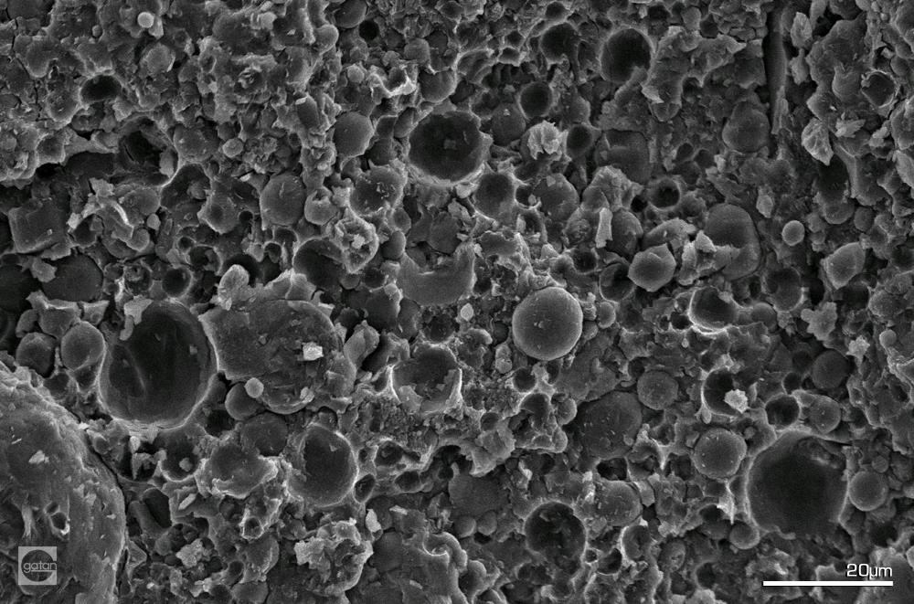

Slide 8

What is cheese?
Cheese is a dairy product that is made from milk.
Cows eat grass and produce milk for their calves because their young stomachs aren’t able to digest grass.
Other milks such as goat and buffalo milk are also used to make different types of cheese.

Slide 9
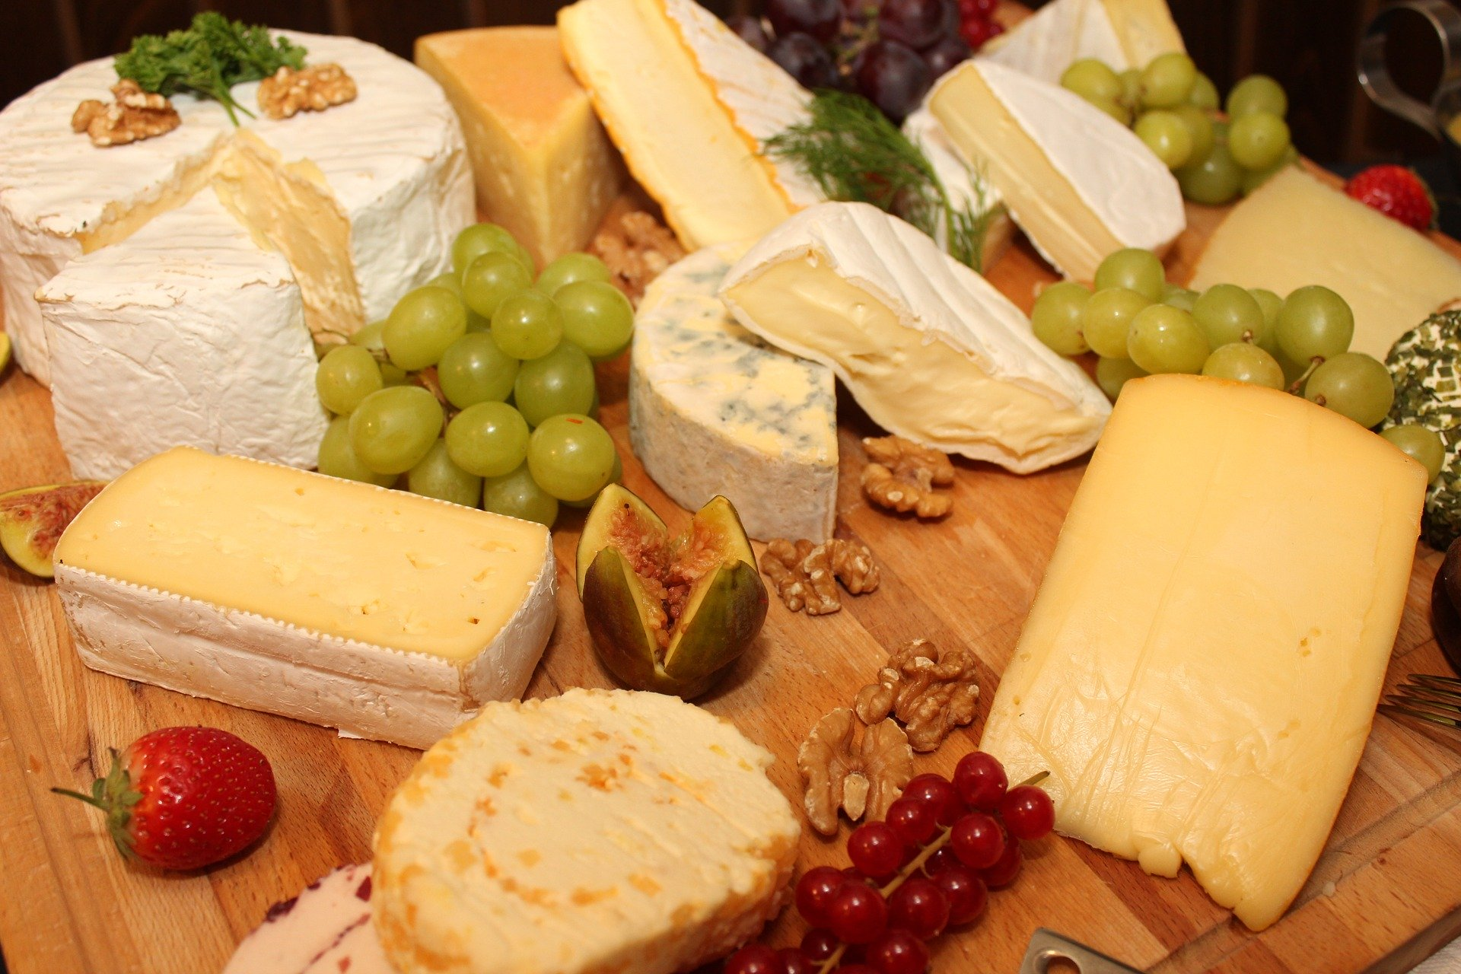
Types of cheese
What types of cheese can you think of?
Wensleydale
Cheddar
Brie
Gouda
Cheesestrings
Stilton
Cream cheese
Red Leicester

Slide 10

What are the blue bits?!
Before the invention of fridges to keep food cool, cheese had to be preserved naturally and so many cheeses contained edible moulds that grew through the cheese and prevented the growth of any harmful bacteria or moulds.
Blue Stilton is an English cheese that gains its characteristic strong smell and taste from an edible blue mould called Penicillium roqueforti and Penicillium glaucum.

Slide 11
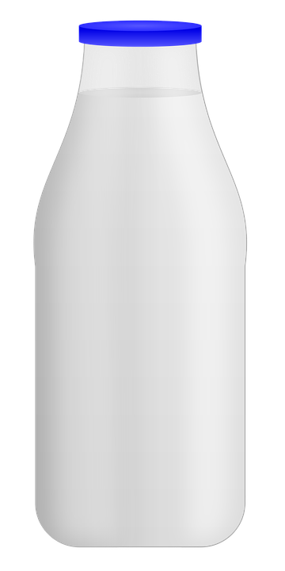
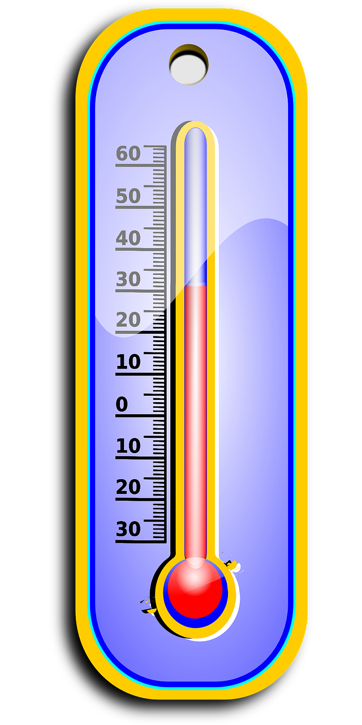



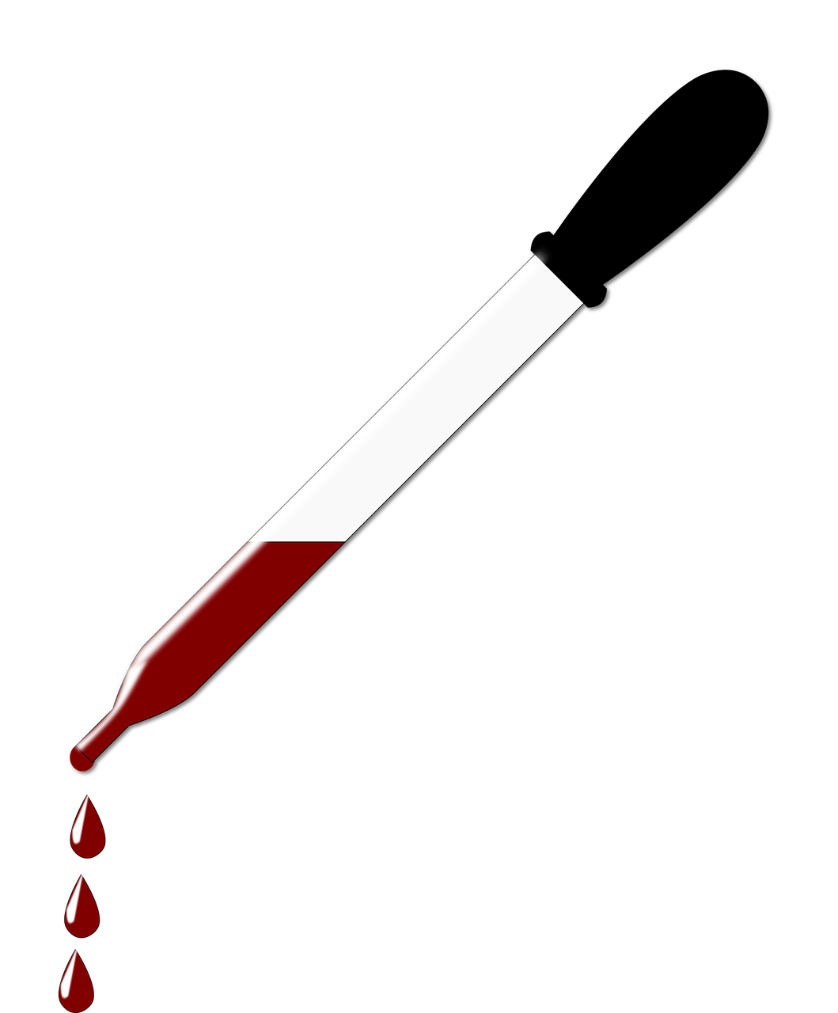
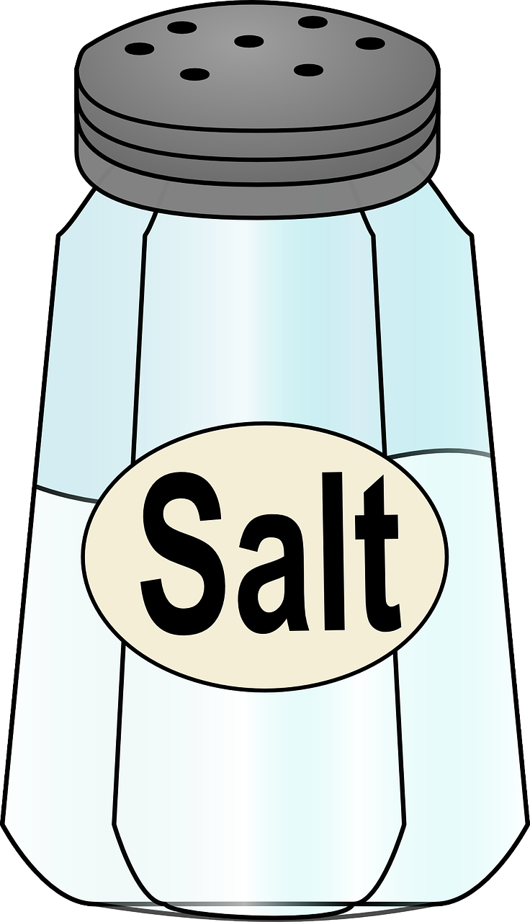
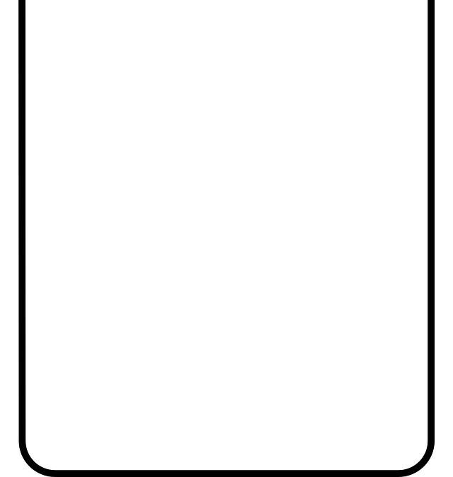
So how do you turn milk into cheese?
1. Acidification
3. Cutting and cooking
Bacteria or acid are added to milk to convert the sugars in milk, called lactose into lactic acid.
The curds are cut with a rake or knife and
heated to release
more whey.
Curd rake
Fats and proteins (curds)
+
or
+
Milk
Bacteria
Acid
Heat
Liquid (whey)
2. Coagulation
4. Shaping and preserving
Rennet contains a special enzyme called Chymosin, which begins to make the proteins and fat join together into curds
and the liquid to
separate into whey.
Once the liquid has been removed the cheese is shaped and preserved with salt or in a salt
liquid called brine.
+
Rennet
Liquid (whey)
Fats and proteins (curds)
Milk

Slide 12

Create a word bank!
What new words have you come across?

Slide 13
Activity one Making Mozzarella

Slide 14
Important: Scientists do not eat their experiments!
Ingredients checklist
1 litre full fat milk
30 ml of lemon juice
5 ml of rennet
Equipment checklist
2 litre plastic pot or jug
1 litre plastic measuring jug
Disposable plastic or paper cup
Sieve or sock
2 Plastic spatulas or spoons
1 plastic plate
~500ml ice cold brine

Slide 15


Method
1. Pour 1 litre of milk into your pot or jug
2. Stand your pot in the water bath to heat your milk to 30ᵒC. Check the temperature is correct by using the thermometer.
30ᵒC

Slide 16

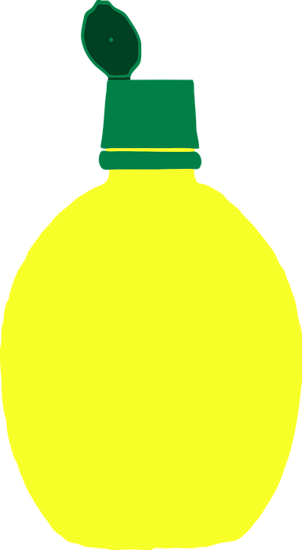

3. Take the pot out of the water bath and gently stir in the lemon juice.
4. Return your pot to the water bath (30ᵒC) and leave for 10 minutes. Be sure to monitor the water bath temperature, it must not go below 30ᵒC or above 35ᵒC.
30ᵒC
Is the mixture changing? Check the colour, smell and consistency

Slide 17

5. Place your pot in the HOT (~55ºC )water bath.
6. Meanwhile, add 40ml of cold water to a cup, mix in 5 ml of rennet.
55ᵒC

Slide 18
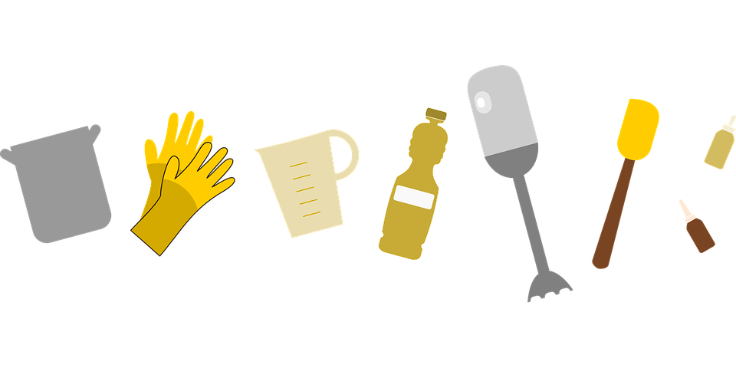
7. Remove your milk from the water bath and add the rennet and water mixture, stirring gently. Then place back in the hot water bath for 10 minutes.
8. Take the pot out of the water bath. Use a spatula to separate the curds from the edge of the pot.
If it doesn’t separate from the edge of the pot cleanly, place the pot back in the water bath for another 5-10 minutes.
55ᵒC
Is the mixture changing? Check the colour, smell and consistency

Slide 19
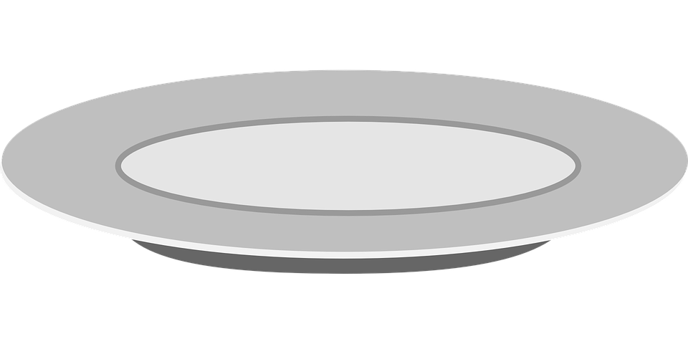
9. Put the sieve over the measuring jug.
Pour the curds and whey through the
Sieve, using the spatula to gently move the curds to allow the whey to drain through. Place the jug containing the whey to one side, you will need this later.
10. Tip the curds onto the plate. Using the microwave, heat the curds until they are hot.

Slide 20
11. Use the spatula to knead and squash the curds, pour the excess whey off the plate into the same measuring jug as before (keep this for later).
12. Fold the curds into themselves and repeat the kneading. The curds will become a solid mass and can be kneaded by hand if not too hot.
! Careful ! Hot !!

Slide 21
13. Pull the ball of curds so that it stretches out. Once you have stretched the curds out a few times you can divide the mass into 4 balls.
14. Add some ice-cold brine (salt water) to the plastic pot and drop the mozzarella balls in.

Slide 22
15. Leave for a few minutes and then place the mozzarella on a plate.
How does your cheese compare to the shop bought Mozzarella?
Can you identify some of the main stages of cheese making?
…. For example, acidification.

Slide 23
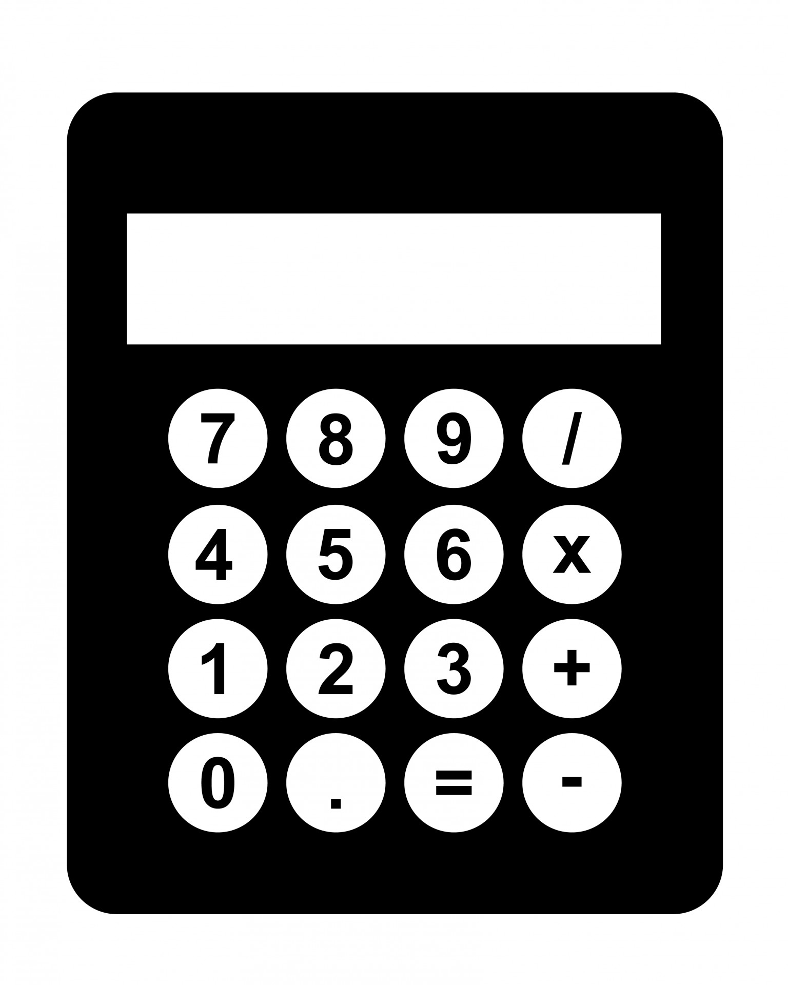
What is the fat percentage of your cheese?
%
You started with 1 litre of full fat milk that contains 3.5% fat, that's 35g fat.
We assume there’s no fat left in the whey, it’s all in the curds.
What you will need
Your measuring jug full of whey
Calculator
Step 1. Work out the total volume of liquid you started with (milk & lemon & rennet mix)
Step 2. Subtract the volume of whey collected in the jug away from the total volume.
Step 3. Divide the starting amount of fat by the remaining volume (once the whey has been subtracted). Then multiply by 100.
This is the percentage of fat in your cheese!
How does it compare to the shop bought?

Slide 24
Writing Activity

Slide 25

Poetry
During this session we will use the concepts, experiences, images and new vocabulary from the science as a starting point for writing poetry!
What you will need:
Pen/pencil
Paper lined or plain
Your word bank
Science images

Slide 26
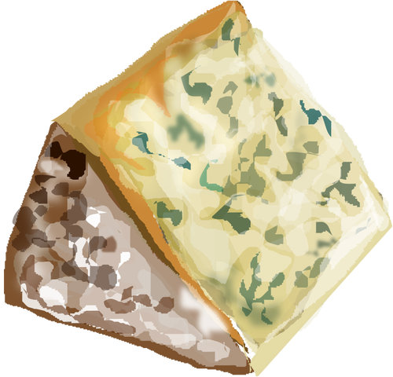
The big cheese: Blue Stilton
I am the big cheese around here
I’ve been the kingpin for quite some time
I’m a blue-veined number one, son of a gun.
Sitting here just waiting for my moment.
I know they are coming for me soon
With their big curved knives
And their cheese wires
And their crackers and chutney.
If they think it’s gonna be easy
Then they got me all wrong
Sure I’ve gone a bit crumbly at the edges
Anybody would, sitting here in the cooler alone
In the dark, day after day, week after week,
Just waiting for them to come.
But they’ll find out soon enough
I’m stronger, tougher, harder to handle
Than I ever was before.
I can smell my power and strength.
I’m no soft touch, cream cheese kind of guy.
No sirree, I ain’t the kind of cheese you stick fruit in.
I’m the real thing. The original
Extra mature, that’s what they call me.
Like I said, I’m the big cheese around here.
Nobody better forget that.
I deserve some respect.
I’m a cheese of distinction.
I got taste, real taste.
When the time comes I’ll be putting up quite a fight
Sure they can cut me
Burn me under the grill
The can grate me to pieces
Smear me with pickles
It doesn’t matter what they do
They’ll see I can still bite back
Maybe they’ll find out they’ve bitten off
More than they can chew.
I’m ready.
Come and get me,
If you dare!
By Mike O’Driscoll

Slide 27
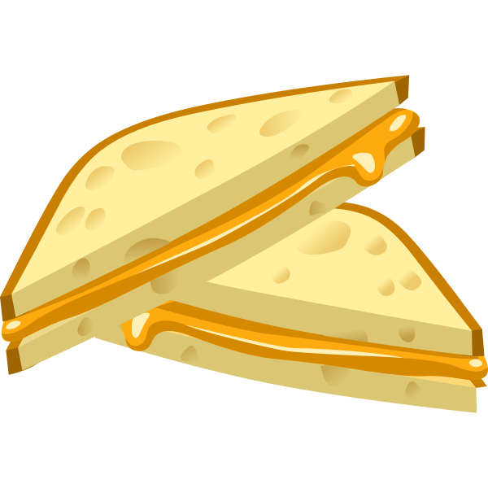
Cheese inspired poetry
What would it be like to be a cheese?
Things to consider;
What type of cheese would you be?
Where would you be? – in the fridge, a sandwich or maybe you are still being made?
How do you feel, and why?
Use your word bank we created earlier to help you create your poem.

Slide 28
Art Activity One
Blind taste test

Slide 29
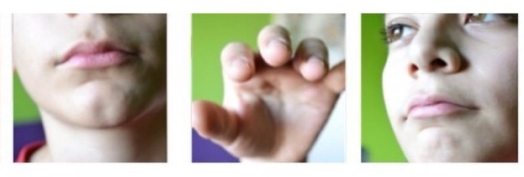
Blind taste test
What you will need:
Blind fold
Selection of cheeses
Fork or cocktail stick
Using your remaining senses; taste, touch and smell, explore the selection of cheeses.
Can you identify any of them?
Which one smells the strongest?
Which is your favourite and why?
Try describing one of the cheeses to someone near you and see if they can guess which one you are describing.

Slide 30
Art Activity Two
Microscopic structures

Slide 31
Microscopic structures
What you will need:
Pen/pencil
Paper lined or plain
Science images
What shapes and structures can you see?
Sketch a sculpture inspired by the structures you can see in the science images.

Slide 32
Art Activity Three
Clay sculptures

Slide 33
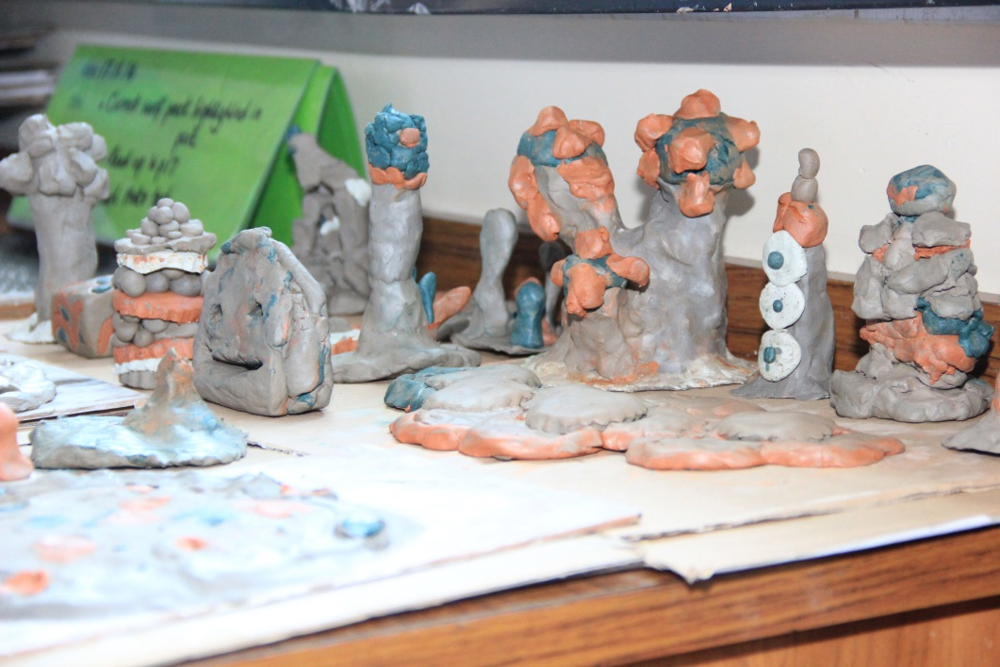
Clay Sculptures
What you will need:
Clay
Sculpting tools
Your sculpture sketch
Using your cheese structure inspired sketch, create your own clay sculpture.
Think about the shape and size of your sculpture.
What different textures can you create with the sculpting tools?

