Slide 1

Lettuce

Slide 2
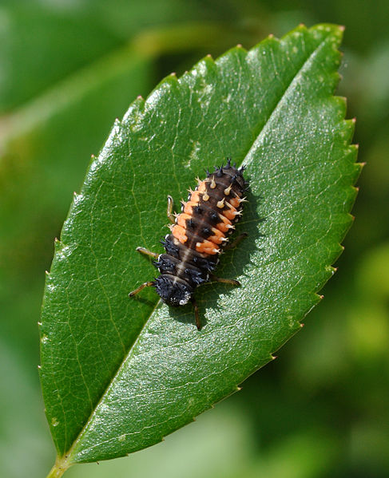

What could this be?

Slide 3
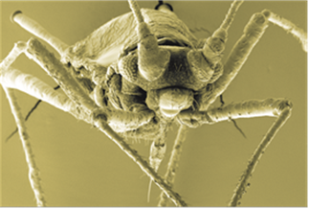
Where might this creature live? What might it eat?

Slide 4
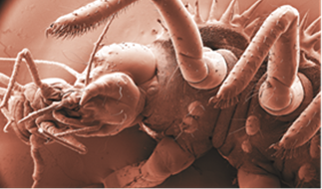
How often might this happen? Would you like meet this creature?

Slide 5
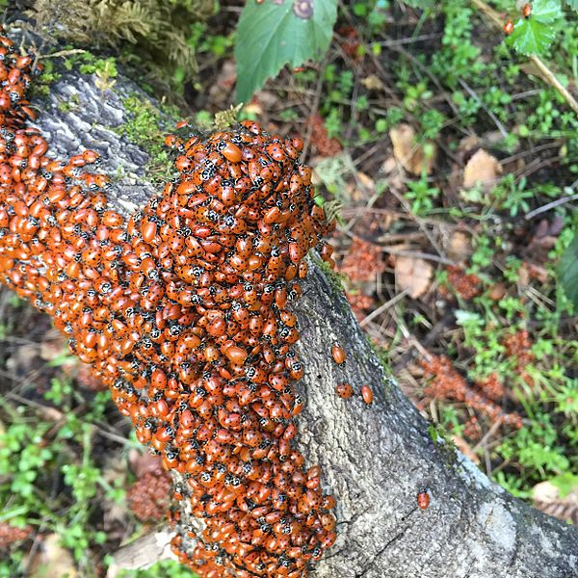
How many different creatures could there be here?

Slide 6
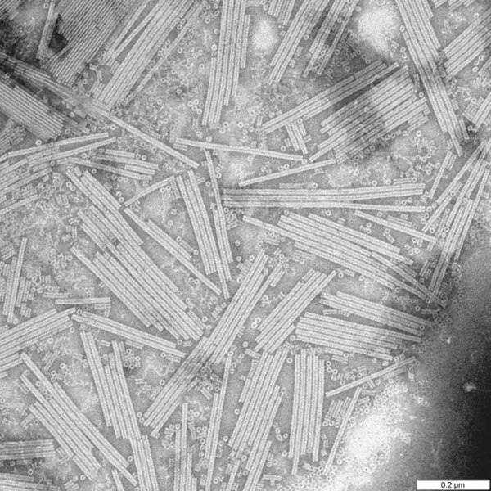
Do you think this is a photograph?
Or perhaps a painting?
Do you think it’s real or fictional? Why?

Slide 7
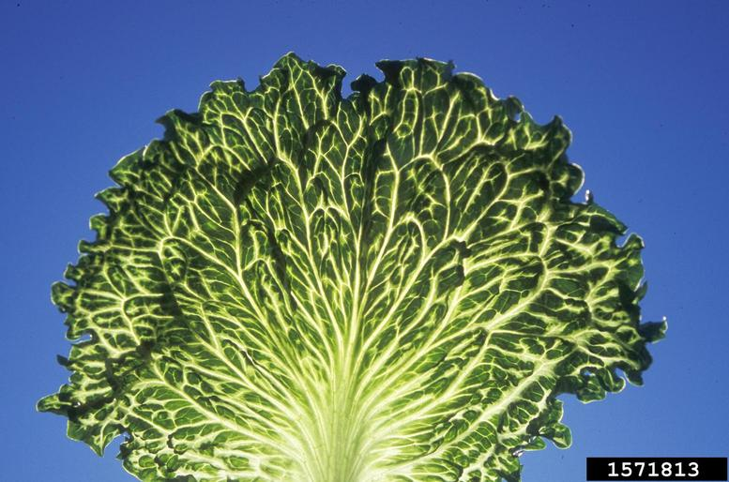
How many different creatures could there be here?

Slide 8
Science Activity One Comparing Salad Leaves

Slide 9
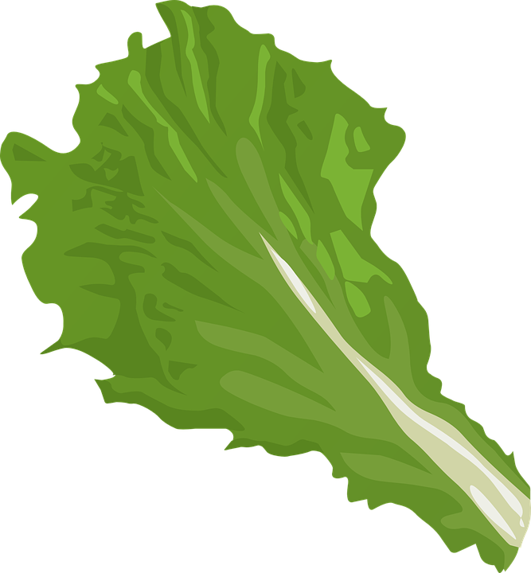

Comparing Salad Leaves
Method
Compare the leaves!
Taste, feel and smell the leaves.
Materials
A variety of lettuce leaves.
Are they all the same – Do you know what some of them are?
What do they taste, smell, look and feel like?
Can you describe one of the leaves to a friend?

Slide 10
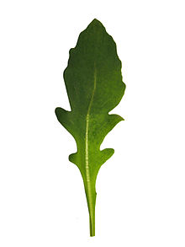
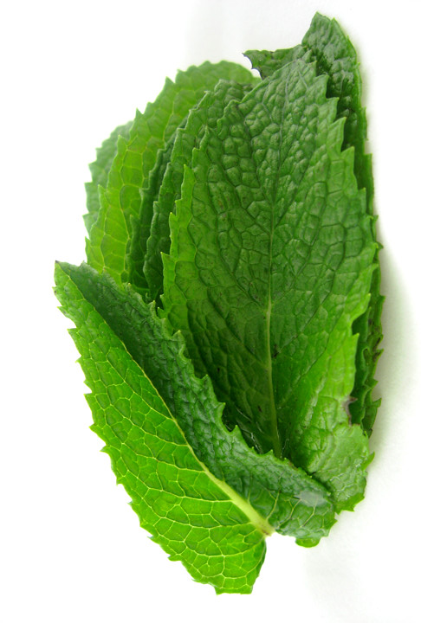
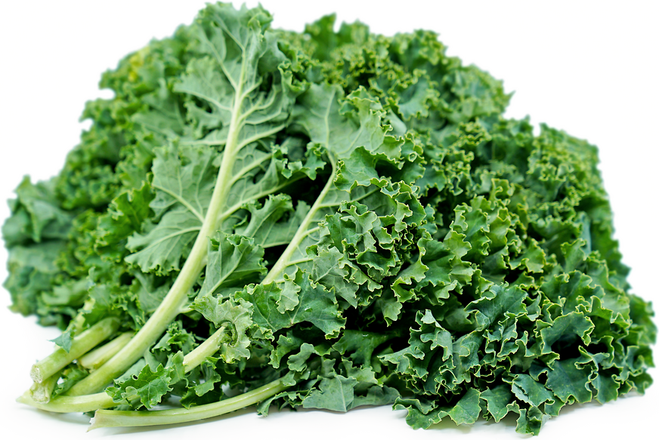
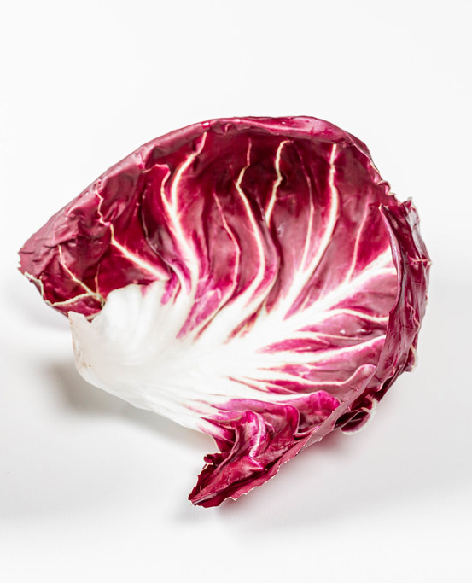
Comparing Salad leaves
Some leaves have a strong smell, like mint.
Some leaves have a strong taste, like rocket.
Tough
Red/purple
Some leaves feel leathery or tough, like Kale.
Peppery taste
Minty Fresh!
Some leaves have a distinct colour, like chicory.

Slide 11
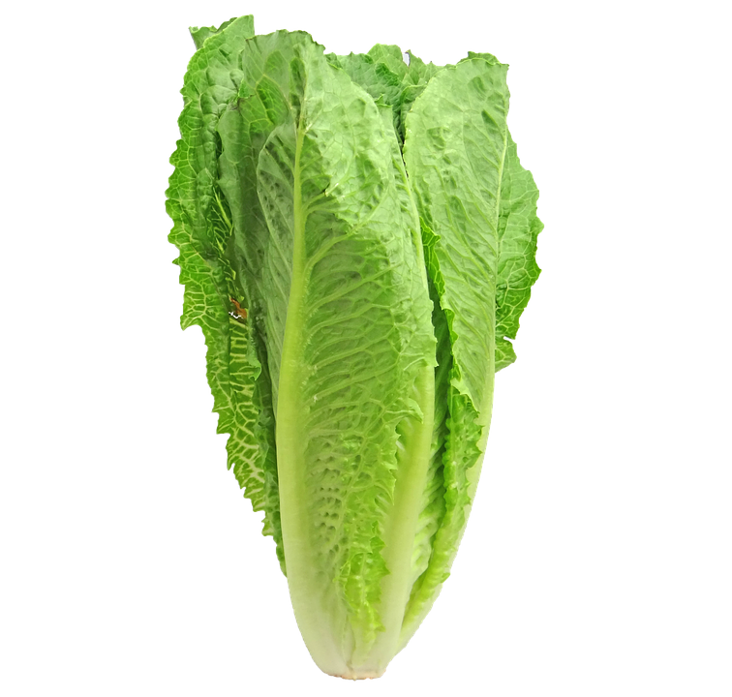
What do we need to grow a lettuce?
Sunlight
Water
Nutrients from the soil
Do we need to protect the lettuce from anything?

Slide 12
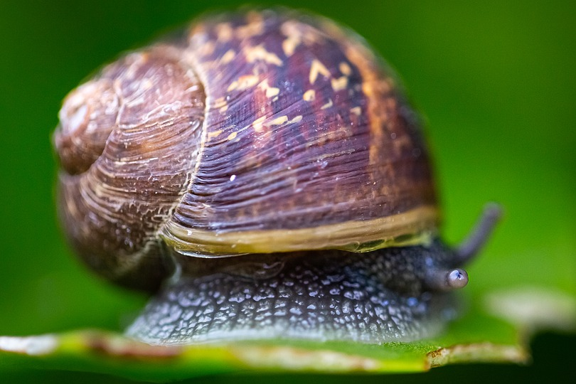
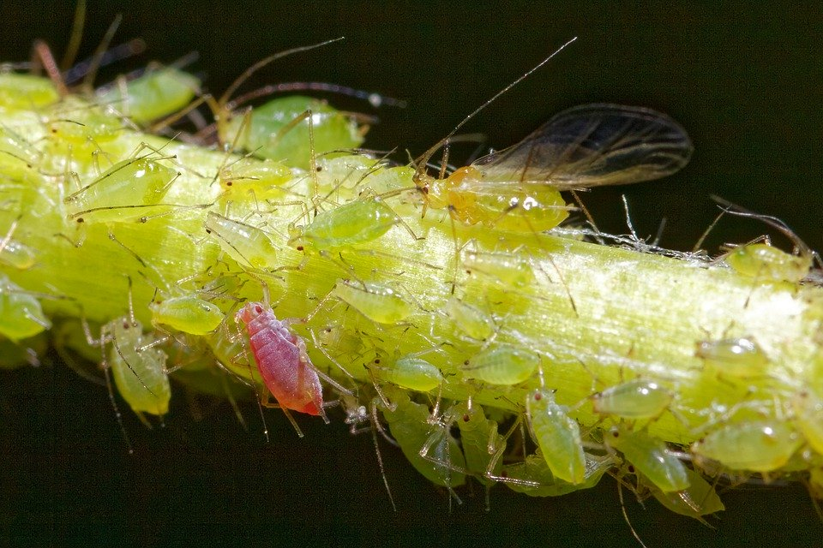
Pests!
Like slugs, snails and aphids

Slide 13
Very close up image of an aphid
Can you see its needle like mouth-part?
Its called a stylet and is used to puncture the leaf or stem of plants to feed on the sugary sap inside.

Slide 14
Plants suffer from viruses too!
Big-vein virus found in lettuce
Can you see the larger than normal leaf veins?

Slide 15
Pests can pass viruses onto other plants!
This is an image of a plant virus called Tobacco Mosaic Virus under a high powered microscope.
The virus causes the plants leaves to be discoloured and stunts their growth.
Aphids and other plant eating insects can transmit this virus and others onto the plants they feed from.

Slide 16

So how do we control insect pests?
Insecticides
(Chemicals)
Kills useful insects like bees!
The chemicals run into surrounding soil and rivers
Kills pests like aphids
=
+
+

Slide 17
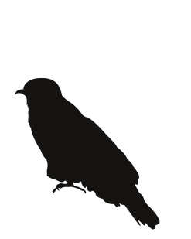


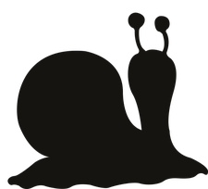

Other types of pest control
Crop improvement
Biological control
Scientist try to develop or grow plants that are resistant to either the insect or the disease they carry.
They can do this by a variety of means, selective and cross-breeding and genetic engineering (when they alter the DNA of a plant)
This is a method of pest control that requires the use of another organism.
A natural enemy of the pest is introduced to control their numbers. For example the enemy will eat the pest.

Slide 20
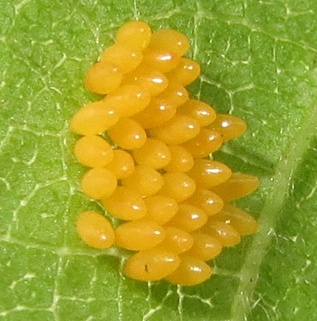
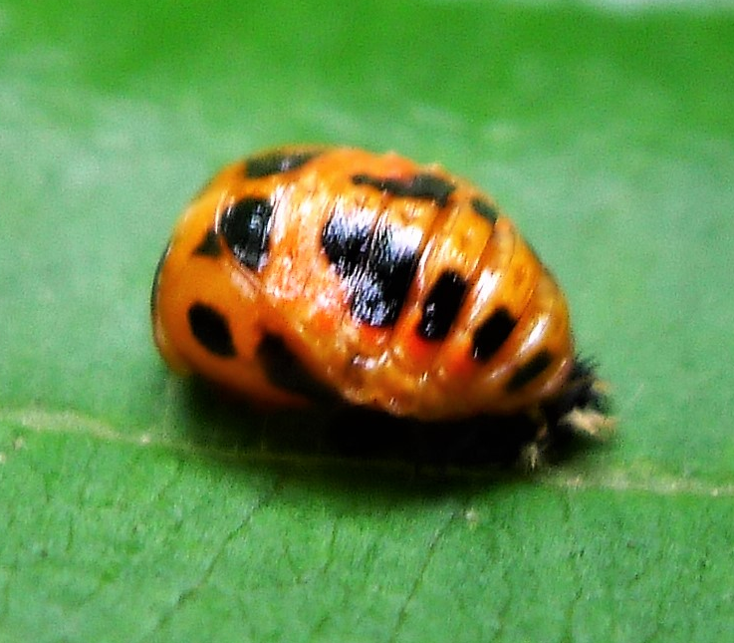
Larvae
Eggs
Pupa
The lifecycle of a ladybird
Adult ladybird

Slide 21

Ladybird larva are ferocious predators of insects and one of their favourite meals are aphids!
Pause here and create a word bank!

Slide 22
Science Activity Two Biological Control Experiment

Slide 23
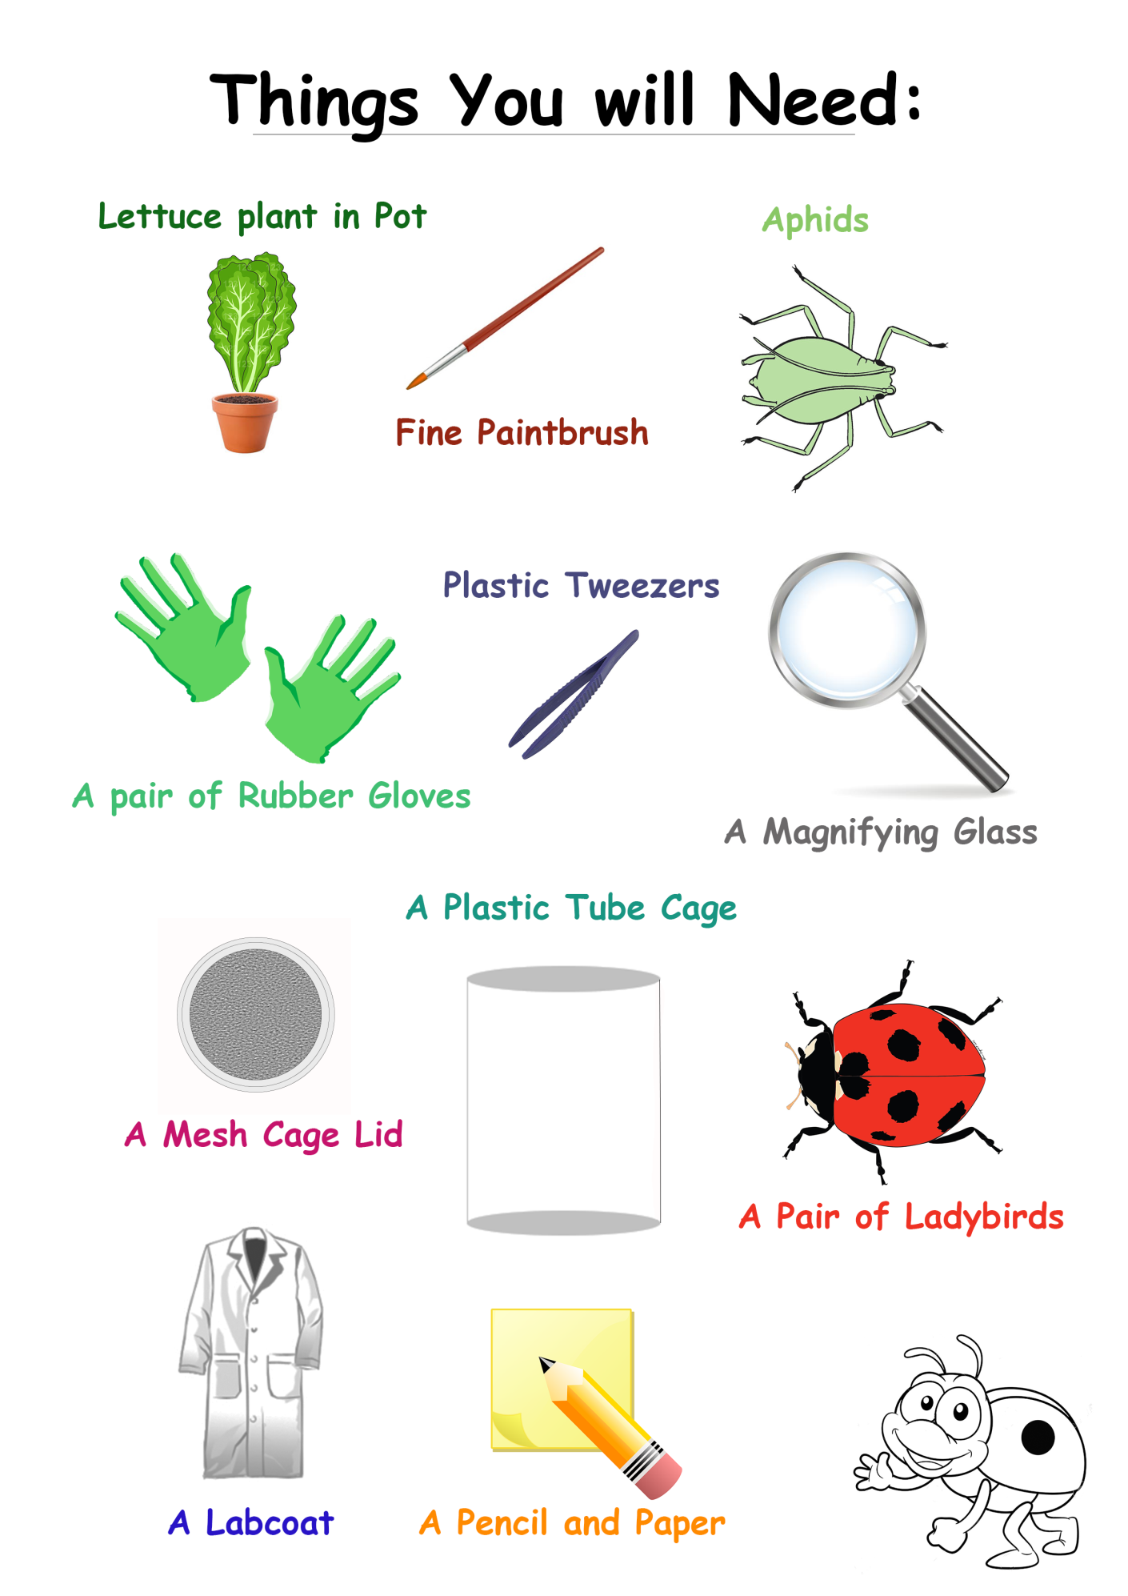
Biological Control Experiment
Today, we will investigate the relationship between predator and prey species, and understand how biocontrol can help farming become more successful.
Checklist
(A plastic bottle with its ends removed)
(Or piece of cloth & rubber band)

Slide 24



Method
2. If you are using them, put on your gloves and lab coat. Then, using the tweezers or your fingers, loosen the soil around the edge of the pot.
1. Collect the items on your experiment checklist.
3. Get your plastic tube cage ready, check that it will fit around your plant.
**
*

Slide 25
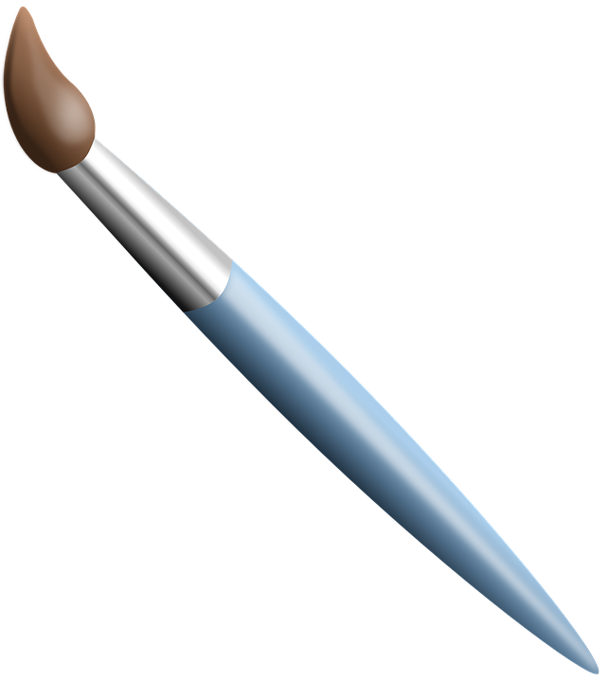

4. A group member needs to carefully hold the plant leaves up and together as the tube cage is placed over the plant.
5. Pop on the mesh lid and carefully push the tube cage into the soil. Not too hard or the cage will collapse. Once in the soil the lid can be popped off.
6. Using a fine paintbrush, take it in turns to collect moving aphids and place them on to your plant. Aim to collect 15 to 20 aphids.
! Only collect moving aphids as those that are still, maybe feeding and moving them may damage their mouthparts !

Slide 26
7. Now carefully add your pair of ladybirds.
Pop the lid on and observe.
Lid which allows air to pass in and out
Things for us to think about:
Ladybirds
- The predator
Plant
How fast are your ladybirds in finding aphids?
Where are the ladybirds going to find their aphids?
- Continue to monitor them over the following days.
Aphids
- The pest!
Clear plastic tube cage for observing

Slide 27
Writing Activity

Slide 28

Poetry
During this session we will use the concepts, experiences, images and new vocabulary from the science as a starting point for writing poetry!
What you will need:
Pen/pencil
Paper (lined or plain)
Your word bank
Science images

Slide 29
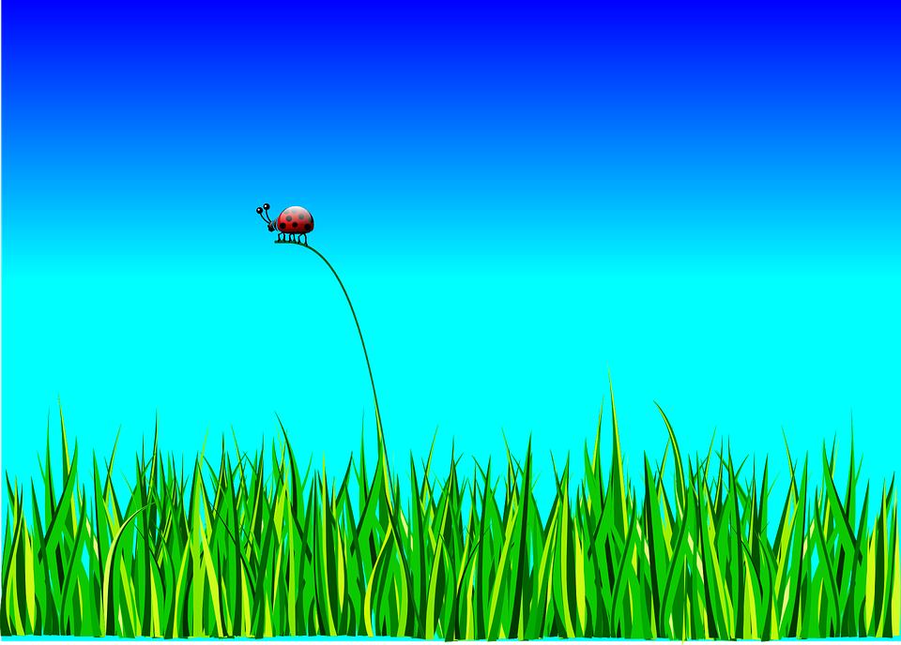
Insect inspired poetry
What would it be like to be an insect?
Things to consider;
Would you be a predator or a prey insect?
What would your world look like, what can you hear, see and smell?
How do you feel, and why?
What would your insect be doing in their world?

Slide 30
What would it be like to be a plant?
Lettuce’s Lament by Julia Webb, 2015
It’s dark in here
And I wish those carrots would budge up,
And there’s something sludgy underneath me –
I think it used to be a parsnip once,
And every time I nod off
You open the fridge door
And the light comes on,
But you never pick me, not even once.
Don’t you know I’d be great
In your lunchbox sandwich,
Or jazzing up your teatime salad,
Me and tomatoes we’re the perfect match.
But no you only have eyes
For that carton of juice, milk for your tea
Or last night’s leftover
Shepherd’s pie and peas.
I’m a depressed lettuce;
With no one to love me
I’m growing soggy round the edges,
It’ll be the bin or the compost heap for me.

Slide 31
Art Activity

Slide 32
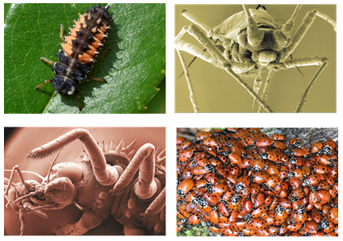
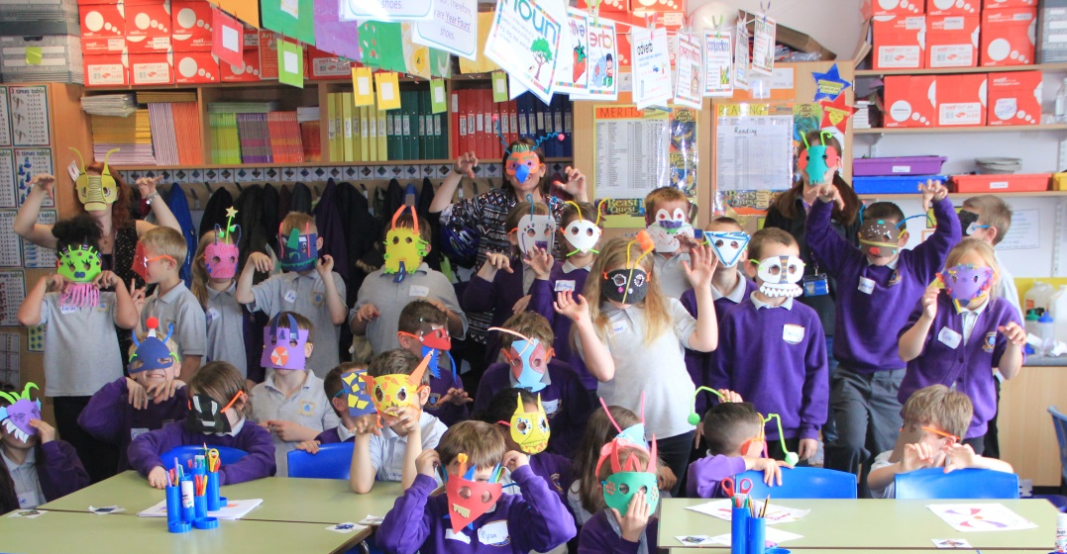
Insect Masks
To create some art which represents your learning, we will be making masks of either the predator, or the prey species.
You have many different materials to work with, and you will need to pay close attention to symmetry, joining techniques, and measuring to create fantastic beautiful masks. Experiment with colours and shapes!
Can you design a scary looking predator with terrifying mouthparts?
Or a camouflaged prey species?

