Slide 1

Yeast

Slide 2
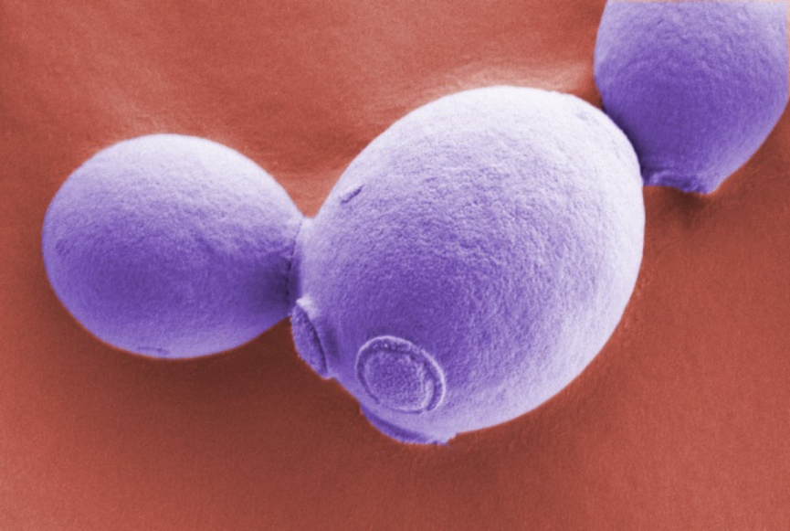

Slide 3
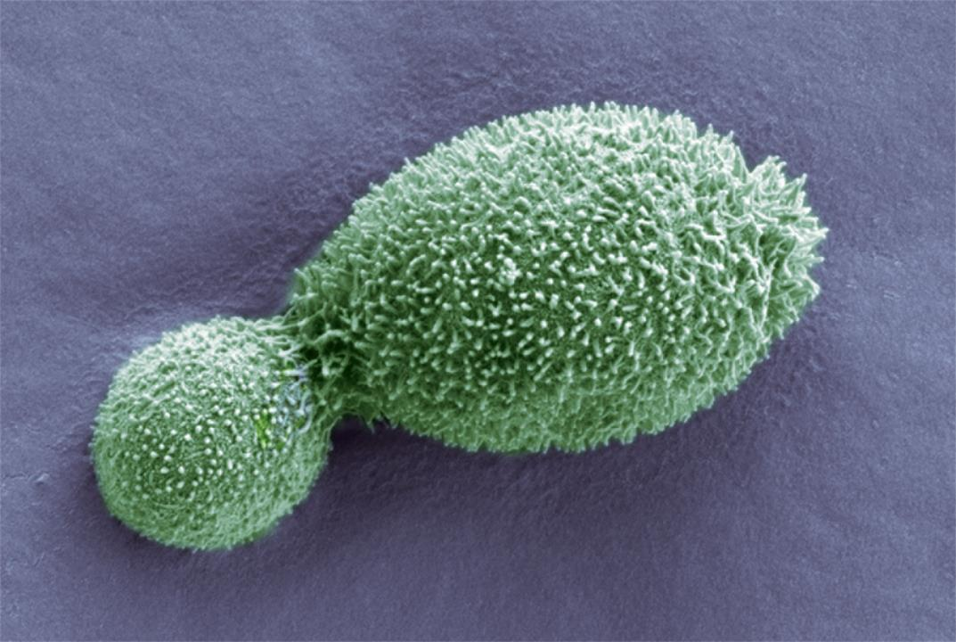

Slide 4
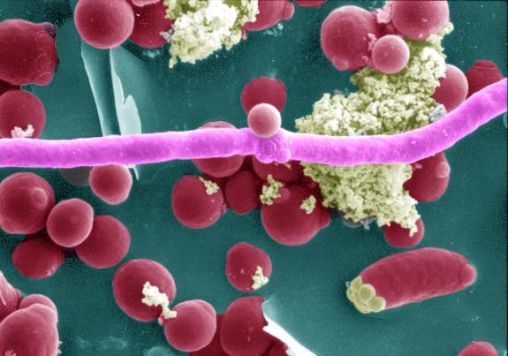

Slide 5
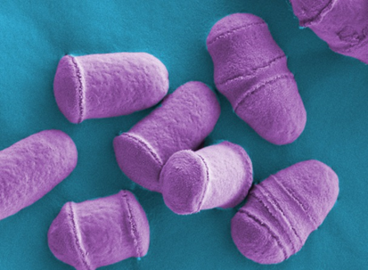

Slide 6
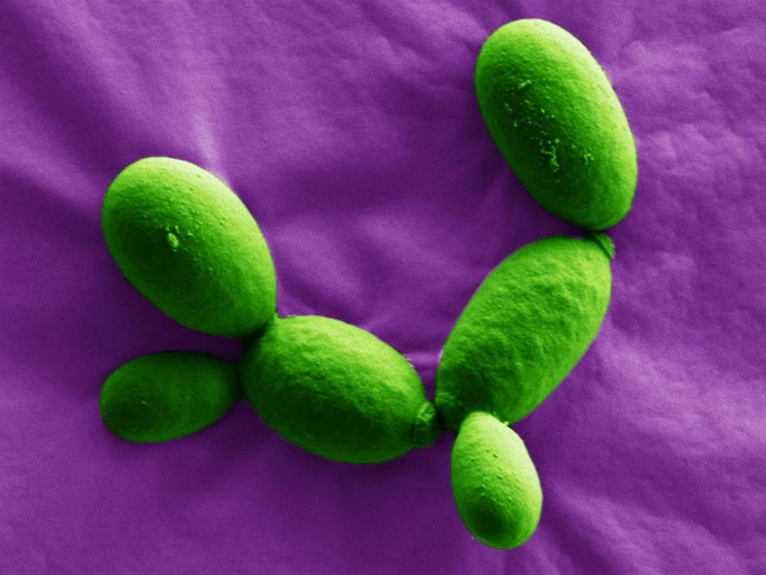

Slide 7
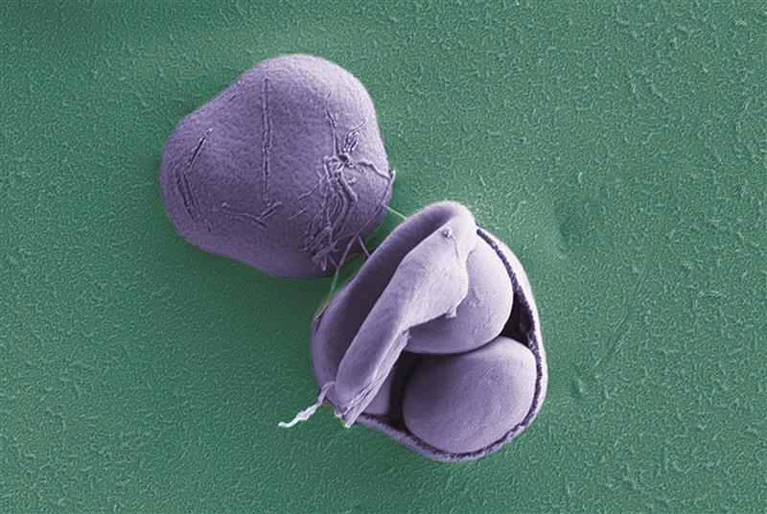

Slide 8
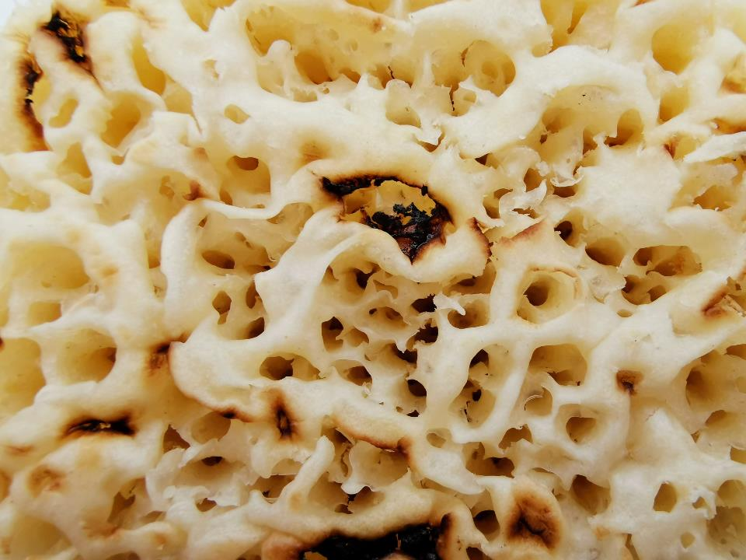

Slide 9
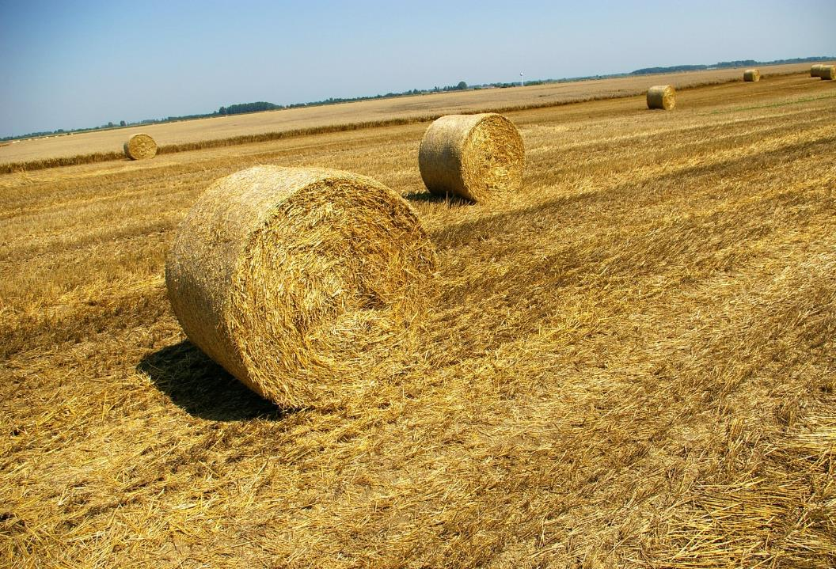

Slide 10




What is yeast?
There are approximately 37.2 trillion different cells in a human body
Yeast is made of just one cell.
It is a single-celled organism

Slide 11


But… there are lots of different types of yeast!
Some yeasts are blobby
(the yeast is “budding”)
Some are hairy looking

Slide 12
Some yeasts become “stringy”
(called filaments)
And some look like bullets
(and split in the middle)

Slide 13

What is yeast used for?
Useful yeasts!
Yeast converts (ferments) sugar into ethanol (a type of alcohol) and a gas called carbon dioxide. Humans have been using yeast for around 10,000 years.
We use it today to make foods and drinks such as bread, beer and wine (and Marmite!).
The carbon dioxide made by yeast forms the bubbles in crumpets.

Slide 14
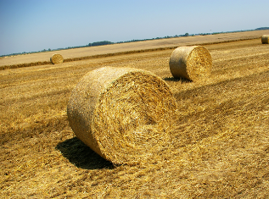


Yeast power!
Yeast ferments (break down) sugars found in waste products like wheat straw and turns it into ethanol that can be used in car biofuel.

Slide 15

Activity one Making Crumpets!

Slide 16
Crumpets!
Ingredients checklist
Strong white bread flour
Plain flour
Caster sugar
Warm milk
Warm water
Bicarbonate of soda
Salt
Yeast
Sunflower oil
Equipment checklist
Bowl
Measuring jug
Spoon
Clingfilm
Frying pan
Crumpet rings
Spatula

Slide 17

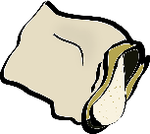





Method (what to do)
1. Add the two types of flour and yeast into the bowl, and stir.
2. Dissolve the sugar into the warm milk, using a measuring jug and spoon.
3. Add the sugar and milk mixture into the flour mix and stir until smooth. This usually takes around 3-4 minutes.

Slide 18

4. Cover the bowl with clingfilm and place somewhere warm for 20 minutes (or up to 60 minutes if it is not warm enough).
Tidy your table!
While we wait…….

Slide 19
Activity two Yeast Balloons!

Slide 20
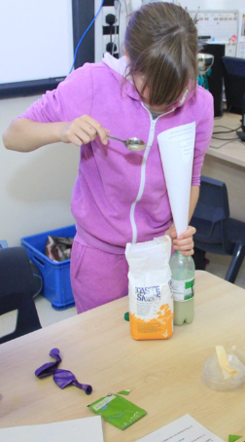
Yeast Balloons
Materials checklist
One plastic bottle
One balloon
One sachet of yeast
Two teaspoons of sugar
Warm water

Slide 21






Method (what to do)
3. Add the sugar to the water and yeast mixture. Put the bottle top on and give the bottle a gentle shake.
2. Add the yeast to the water
1. Pour warm water into the plastic bottle, so that it measures 4-5cm up the side.
4 to 5cm

Slide 22





4. Remove the bottle top and attach the balloon to the top of the bottle.
5. Place the bottle in a warm spot and watch!
What is happening to the balloon?
Why is it happening?

Slide 23

Activity one Making Crumpets!
Part 2

Slide 24


5. Mix the bicarbonate of soda and salt with the warm water and stir into the batter in your large bowl.
6. Cover the bowl again and leave it alone for 20 minutes.

Slide 25
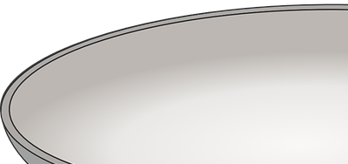
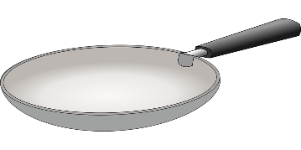
Cooking the crumpets
8. Drop 2-3 tablespoons of batter into each ring. Cook until holes appear and the top of the crumpet is no longer runny.
Approximately 4-5 minutes.
Then use a spatula to turn the crumpets over and cook for a further 2/3 minutes.
7. The crumpet batter is now ready to cook!
Grease a frying pan and four crumpet rings with sunflower oil and place on a medium heat.

Slide 26
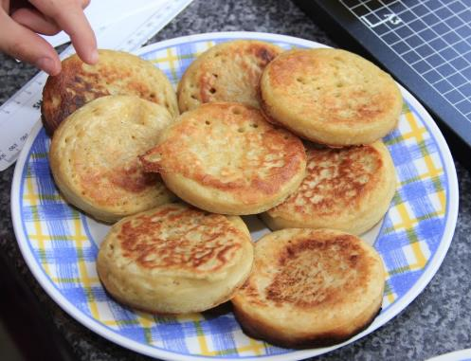

The crumpets are now ready to eat. You can also let them cool and warm them up later in a toaster!
What has caused the holes to appear in the crumpet?
How did the batter change when we added things to it and what did it look like?
Create a word bank!
What new words have you come across?

Slide 27
Activity Three Yeast Alive!

Slide 28
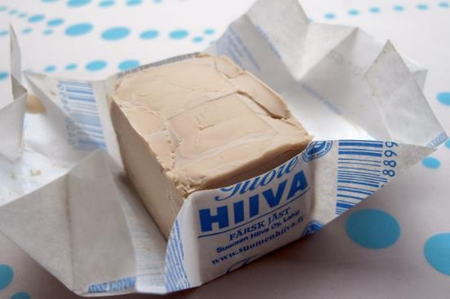
You will need
A bowl or plate
Fresh yeast
Sugar

Slide 29



Method
2. Put the yeast in a bowl or plate and add sugar.
Stir until the mixture changes
1. Open the block of fresh yeast.
What does is smell, look and feel like?
How does the mixture change?
And why??

Slide 30
Writing Activity

Slide 31

Poetry
During this session we will use the concepts, experiences, images and new vocabulary from the science as a starting point for writing poetry!
What you will need:
Pen/pencil
Paper lined or plain
Your word bank
Science images

Slide 32
Yeast inspired poetry
What can you see when you look at the science images?
Some things to think about:
What colours can you see?
Describe what shapes you can see.
What does it look like?
Do any of the images remind you of anything?

Slide 33
Art Activity 3D Yeast Structures

Slide 34
3D Yeast Structures
Materials
Cane
Masking tape
Craft pliers
PVA glue
Sponge/paintbrush
White tissue paper
Coloured tissue paper

Slide 35
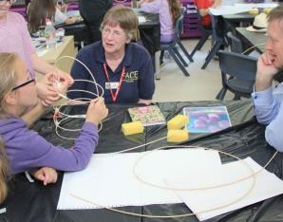
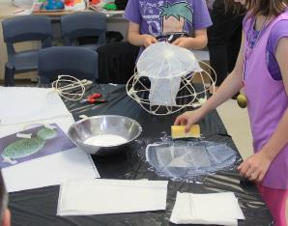
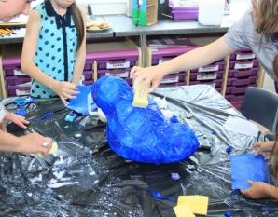
1. Bend the soaked cane to begin creating your yeast structure. Begin with creating hoops and securing with masking tape.
2. Once you are happy with your yeast structure use the PVA glue mixture and a sponge to apply white tissue paper and allow it to dry.
3. Refer back to the yeast images and choose a final colour tissue paper for your structure and apply it with the PVA mixture.
Now allow your structure to dry!

